Slide 1


Slide 2

Achieving stakeholder involvement
Ade Sawyerr – Management Consultant
Ubele Associate
Fundraising support

Slide 3

Stakeholder involvement
Identifying your stakeholders
Exploring different levels of engagement
Involving them into a sustainable partnership
Participants would be aware of who their stakeholders are
Participants will understand the levels of involvement that helps the organisation grow
Participants will be able to deploy different mechanisms to keep their publics always close to them

Slide 4
What is stakeholder involvement
Clear statement of values, policies and arrangements for involving stakeholders
Effective mechanism to understand impact on stakeholders
Standards of service provision
communicated to all stakeholders
Monitoring to ensure consistency and inclusion
Work with stakeholder led organisations to improve quality
Open door complements and complaints policy with external arbitration

Slide 5
Who are your stakeholders and why?

Slide 6
Our stakeholders
regulators
Funders
and
commissioners
The community
Other
providers
The organisation
Staff
And
volunteers
Members
and
Users

Slide 7
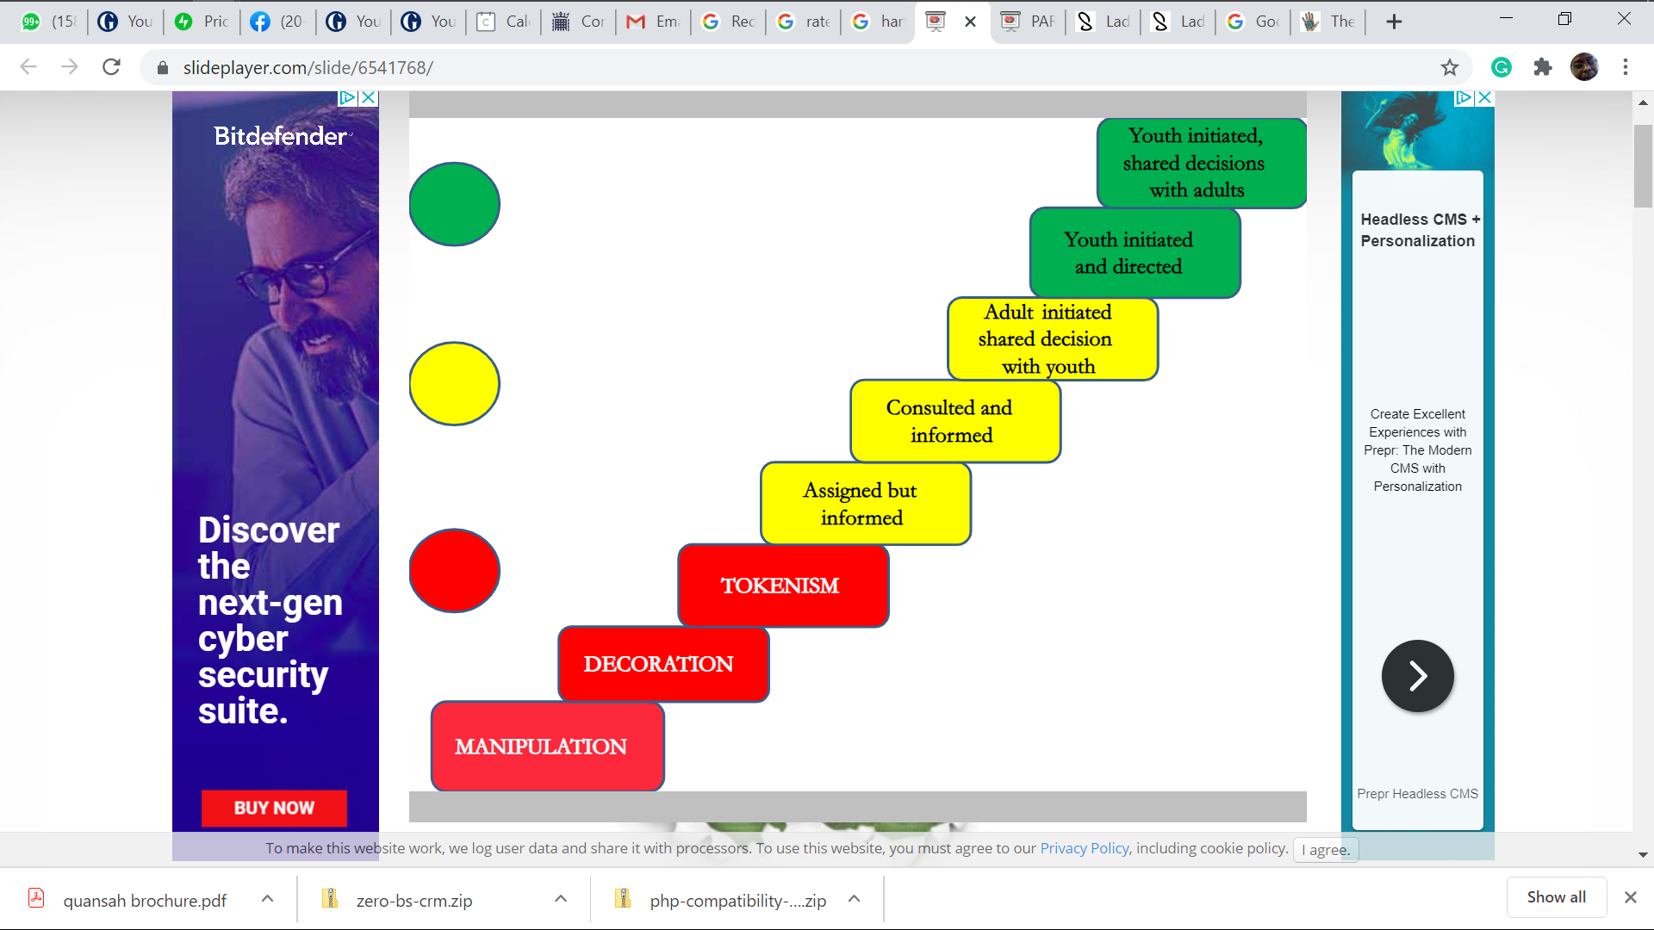
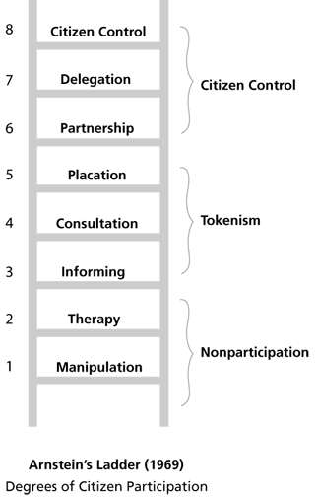
Ladders of involvement

Slide 8
Types of involvement
Management centred
Existing structures, users participate
Consulting with usual suspects
User centred
Objectives and priorities set by users and adopted by organisation
Voicing opinion and participating in decisions
Which helps to deliver a better service?

Slide 9
Barriers
A mix of service users
Type of leadership
Glass ceiling of service users
Fashionable and cosmetic tokenism
Involvement of few suspects
Continuity issues

Slide 10
Why is stakeholder involvement important?

Slide 11
Importance of stakeholder involvement
Beneficiaries
Impact on beneficiaries
Involvement of people and communities
  Consultations to shape the project
  Involving beneficiaries in project planning
  Involving beneficiaries in day to day running of the project
Evaluation

Slide 12
Marketing defined
Process of planning, analysing, identifying, of needs of target group and satisfying those needs and demands with the right services advertised and publicised in the right medium, delivered at the most convenient location at an acceptable charge for a surplus.
Social marketing has the prime objective of achieving social good
Matching our services to needs of our users
Communicating with various publics in an effective way

Slide 13
Strategic Marketing
New
Providers
Competition
amongst
existing
providers
Funders
Users
Similar
services

Slide 14
Marketing research
Stakeholder analysis
Identifying needs of target groups
  Who are our users
  What service they require
  When they require it
  How they require it
  Where they require it
  How much of it they require
  Ongoing and reviewing
Influencers and users
Competitors and collaborators
Costs and funders

Slide 15
Marketing analysis
Making informed decisions
Tools of research
  Secondary research – statistics
    Reports in libraries and websites
  Primary research – focus on users
    Questionnaires and surveys
    Focus groups
  Forecasting of demand
  Minimisation of risks
  Allocate resources
  Schedule delivery

Slide 16
Traditional elements of marketing
Products and services
  Who will use our services
  What must we provide
Placement and distribution
  Where do we provide
  Accessibility and outreach
Promotion and advertising
  what do we say and where
Pricing and costing
  How much does it cost
  Who pays for it

Slide 17
Segmenting and targeting the service
Formal service
Augmented service
  Different users want different things from us
  Geographical, age, class, gender, ethnicity
  Severity of need
  Special features
  image
  What is the core service
  Packaging
  Branding
  quality
  Need to continue to develop the service to match the changing needs of the users
  Standardised service against specialist service

Slide 18
Placing the service
Location factors
Physical environment
Channels of referrals
Accessibility issues
Convenience of users
Disability issues
Subcontracting relationships

Slide 19
Pricing the service
The concept of primary and secondary users
Who takes the purchasing decision
Purchasers and influences
Best value issues
Full cost recovery issues
  Set up costs
  Direct costs
  Overhead costs
  Management costs
Membership and usage fees
Affordability
Making payment easier
Premium product and service

Slide 20
Promotion and Publicity
Image and target client group
The purpose
Awareness
Interest
Desire
Action
The communication mix
The content
The medium
The process

Slide 21
The Content
Who we are and what we do
Who we serve, where and when
How to contact us
Example of what we do
Testimony and endorsement
Benefits
Next steps

Slide 22
The Message
Service delivery and information to users
Publicity is not paid for
Advertising is paid for
Staff and volunteer recruitment
Message to sponsors and funders
Message to members
Message to general public
Proposals to funders

Slide 23
The Media
Television? Radio?
Press
  National, local, ethnic, trade or sector
  Publicity or advertising
  Articles
Directories
Exhibitions and fairs
Open days
Newsletters
Poster and brochures
Social Media
Email and mailing lists
Website
Reports

Slide 24
Connecting with stakeholders
Stakeholder | Media | Message | Content | Frequency
Users
Staff + volunteers
Regulators
Funders + commissioners
Collaborators and competitors
Wider community

Slide 25
Mechanisms
Decide method
Clarify objectives
Determine scope
Plan and Involve
Analyse and Report
Feedback and Evaluate

Slide 26
Methods of involvement
Information exchange and consultation on specific issues
Participation and partnership
Control and decision making
Importance of policies:
  provide information about the organisations vision about user involvement
  State the principles underpinning involvement
  state why the organisation is involving stakeholders
  Provide definition about who and what and when
  Highlight the expected outcomes

Slide 27
Techniques
Feedback forms and surveys
Leaflets and written submissions
Questionnaires, Interviews and discussions
Consultations, User forums and focus groups
Meetings and conferences
Panels and seminars
Expert users and providers
Board membership

Slide 28
Marketing oriented – user focused
Know your service
Know your markets and users
Know who else provides a similar service
Ask your users what they want
Tell the funders and commissioners what the users want
Ensure that you can reach your users all the time
Find out how to improve service delivery
Make it easier for your users to approach you
Marketing is the only way you satisfy your stakeholders
Marketing is the only way you achieve sustainability

Slide 29
Who are the users
Who are the purchasers and commissioners?
  Recognition that users are generally the best judge of their own needs does not sit comfortably with the concepts of 'charity', 'philanthropy' and 'benevolence' and the sector has been criticised for being remote and paternalistic. Although the process can be difficult and time-consuming, organisations should ensure further progress is made towards user empowerment.
Direct experience of services
Are there other beneficiaries
Are there secondary users and influencers
move towards democratic control

Slide 30
Role of users
Development and Testing
Researching needs
Consultations and discussions
Focus and user groups
  Commenting on services and activities
  Deciding on most effective range
  Commenting on type of services
  Commenting on delivery modes and methods
Service Delivery
Self help providers
User volunteers
Expert users and advisers
Empowered providers

Slide 31
Staff involvement
Quality standards
clear statement of purpose required
requirement to involve all groups
anti-discriminatory approach
Involve hard to reach groups
extent of influence should be clear
Feedback for all involvement exercises
support, preparation and training for all
clarity about resources and finances
Monitoring
Comments and suggestions
Views on the service
Focus groups
Communicating complaints and compliments
Case studies
Reviews

Slide 32
Advisors and trustees
Advisory
Panel of experts
Consultation and participation issues
Feedback at all levels
Setting targets
Working on policies
Working on integration strategies
Trustees
Involvement in decision making
Conflicts of interests sometimes arise in representation and benefit
Training may be needed to ensure suitability and make up skills deficit
Trustee role of duty of care to organisation
Assisting in recruitment
Most viable form of representation

Slide 33
Regulators and funders
Monitoring reports
Evaluation reports
Invitations to project launches
Contact with issues to be resolved
Seminars, conferences and exhibitions

Slide 34
Other providers
Provider groups
Meetings and seminars
Conferences and exhibitions
Roundtable discussions
Exchange of reports
Collaborations and partnership and consortiums

Slide 35
Enabling factors
Focusing on priorities
Committed leaders
Good communication between users, staff and trustees
Committed users
Meetings, networks, forums, shared practices
Resources to make it happen
Policy and effect on funding
External support and scrutiny
Equality of opportunity
Continuous monitoring and evaluation

Slide 36
Why should stakeholders be involved
Ensure we respond to relevant needs
Make the services effective and efficient
Identify gaps in service provision
Ensure provision of better range of services
Improve access to service provision
Ensure sustainable provision
Credible to all stakeholders
Make a social and societal impact

Slide 37
Levels of involvement
Level 1
Level 2
Level 3
  Aims and objectives defined user group and services
  Management reports which cater for needs of users
  Information leaflets and flyers
  Accessible records about users and equal opportunities
  Records of feedback from users
  User satisfaction surveys
  Research reports, government strategy and relevant policy documents
  Results of user satisfaction reports on targets
  Records of complaints, suggestions and action taken
  Records of feed back complaints and suggestions
  User involvement policy and plan
  Board minutes, minutes of user forums, results of surveys and reports
  Results of needs assessments
  Feedback from users and strategic planning documents
  Reports of best practice in similar organisations
  Records of comments and suggestions
  Analysis of complaints and suggestions received and action taken as a result

Slide 38
Involved stakeholders
regulators
The community
Other
providers
The organisation
Members
and
Users
Staff
And
volunteers
Funders
and
commissioners

Slide 39

Q&A

Slide 40


