Slide 1

Mali Enterprising Leaders
(MEL)-England
Webinar 2 - Alternative sources to grant funding
Date 3rd March 2021
3.30pm – 5.00pm

Slide 2

Welcome | 3:30 pm | Karl Murray
Social Investment Business Q & A | 3:33 pm | Marianne Heyl Business Development Manager
Individual Donors | 4:03 pm | Gina Osbourne
Major Donors | 4:14 pm
Community Fundraising | 4.23 pm
Digital Fundraising | 4:34 pm
Tips Direct Mail, Personal Solicitation, radio appeals, telephone | 4.43 pm
Q & A | 4:50 pm

Slide 3

Social Investment
& Q&A

Slide 4


Individual Donors
Do you know you your supporters?
  Characteristics
  Why they support your organisation
  Preferred way of giving
  How much they have been giving
  Individuals you can approach
Make a list of your potential supporters
  Build on their motivation
  Hesitations or reasons why they are not giving
Make Contact
  Letter, email, phone, personal networks
  Promotional literature, shopping list
  What the appeal is about, how much money is needed, good news story/ case study
Build a Supporter Base

Slide 5
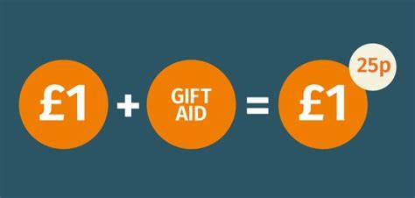

Major Donors
Identifying the donors that can do much more for the organisation
Individuals that make larger donations £300+ Cultivating relationships
Look at current donations by value
Utilize your Patrons/ambassadors
Set up forum, tailor-made letter, online meet & greet event (Chief Executive)
How they can support the organisation
Gift Aid

Slide 6

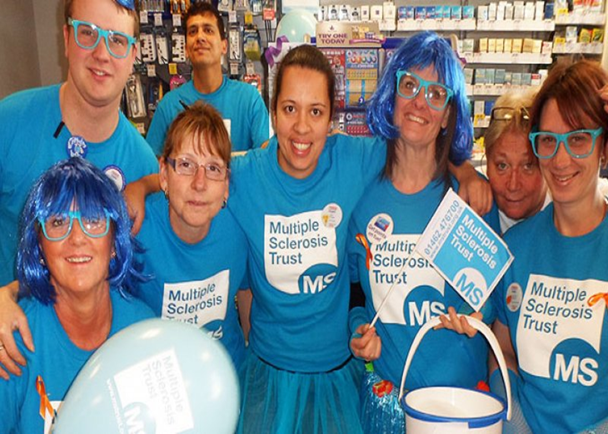

Slide 7


Participatory fundraising which is visible in the community; e.g. MacMillan’s Coffee mornings
Inhouse events organised by the charity , Sponsored Walks , bike rides, runs & Quizzes
DIY Fundraising led by supporters who plan and run a fundraising activity, attractive to millennials.
Big events London Marathon
Larger charities have a dedicated page for DIY fundraising activities https://www.alzheimers.org.uk/
DIY supporters use social media
Supporters raising funds on your behalf need to be briefed in accordance of the law.
Charity should provide the appropriate materials e.g. logos; statements and right permissions to undertake fundraising, safety, risk assessments, data protection safeguarding and insurances
Larger charities have resources to plan, monitor & evaluate events. Smaller charities will need to set up a task group finding people who can put in the time.

Slide 8
Digital Fundraising
Funds raised digitally via computer, laptop or mobile phone
  Online donations via website or fundraising page
  Digital fundraising campaigns
  Sponsorship via JustGiving page
What are you looking to achieve? Think about targets, deadlines and how it will be measured
Attract How will you get people to discover you and your campaign, website, social media & newsletter
Persuade How will you convince the visitor to give, type of messaging, images & videos
Convert What is your visitors website journey, how will you convert visitors into donors. How good is your website?
How will you give visitors the reason to continue giving, thank you letter, comms to update on impact of their donation
Upsell and co-opt Ask donor to share via social media news of donation or you can find out if they are interested in other activities organisation is doing.
Attract
Persuade
Convert
Notes:
Fund opened today

Slide 9
Digital Fundraising
Your website Donate page, link to giving platform, relevant calls to action, good content
Google Analytics Report on traffic to your website; programmer can set up goals for breakdowns on campaigns you are running
Newsletter every 3- 9 weeks make it punchy and useful to audience, Mailing list use Mailchimp, website subscription form
Social media Just Giving comes via Facebook, emotive images/ stories work on Facebook. Twitter can be used locally for interaction & promoting your campaign and YouTube to host any video material, remember to add thumbnail/tags for search lists. Tik Tok & Snapchat
Local radio stations and media platforms
Content assessable for mobile phone use; opportunity test ideas.
Retain
Upsell
Convert
Start to plan how you wish to use Digital Fundraising, your resources and list the platforms/channels you audience is currently using
Notes:
Fund opened today

Slide 10
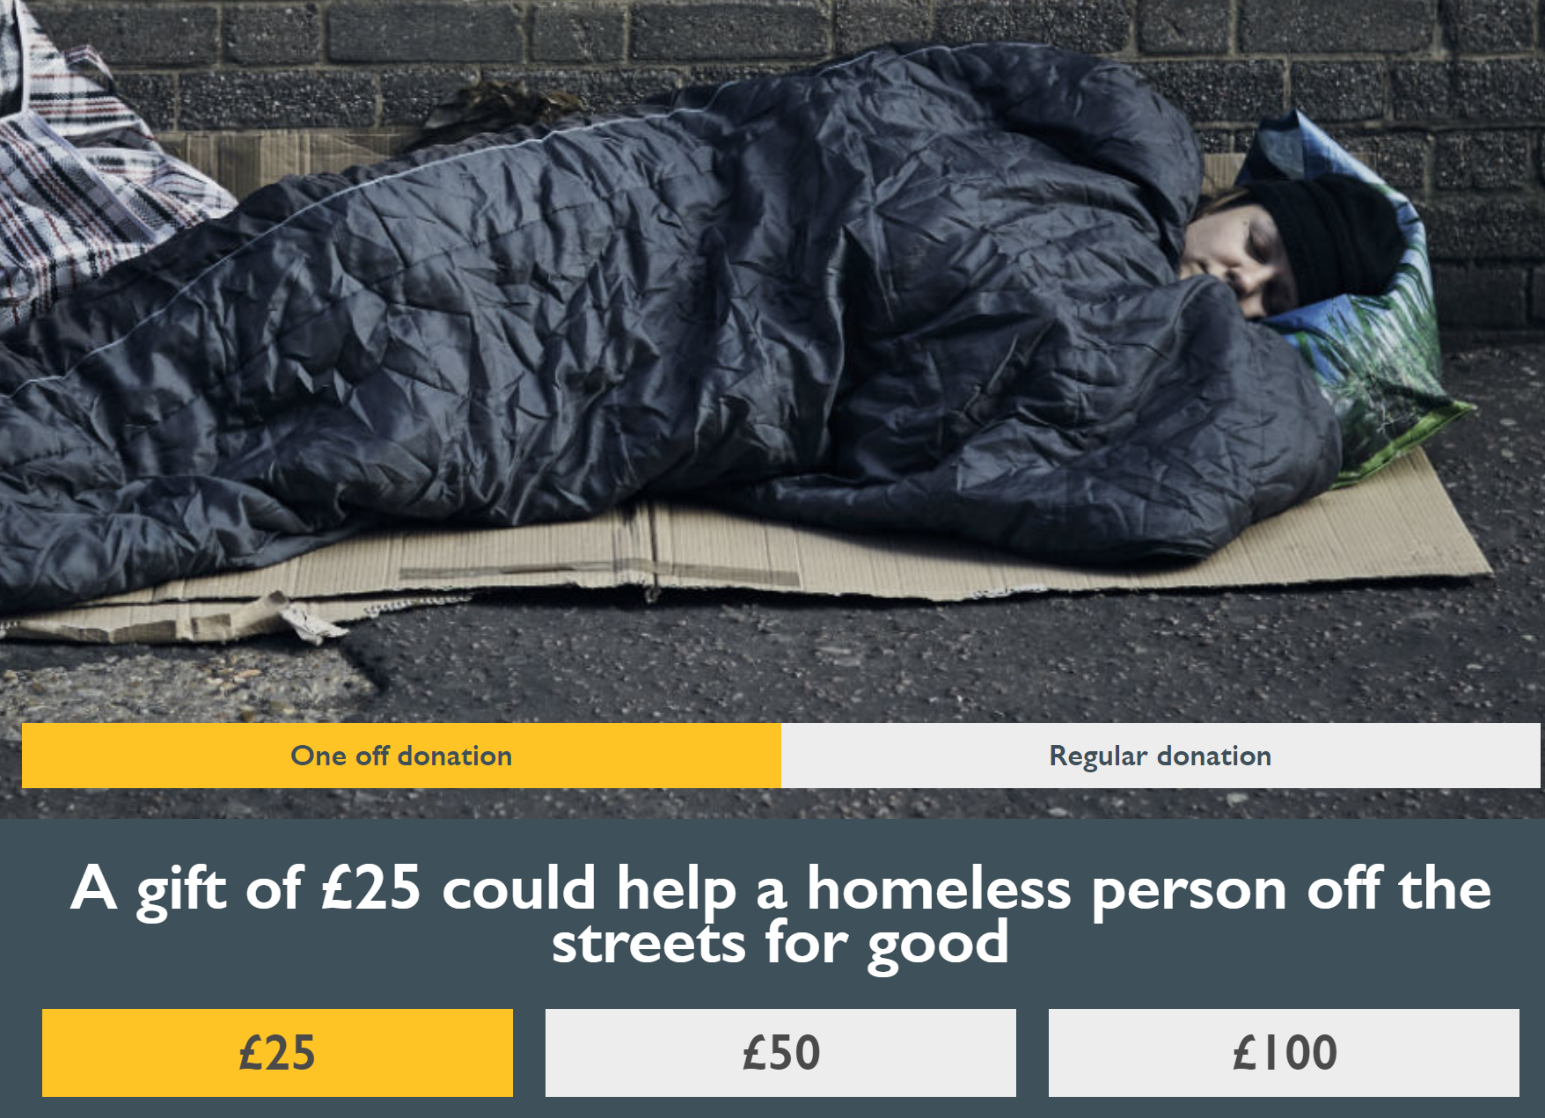
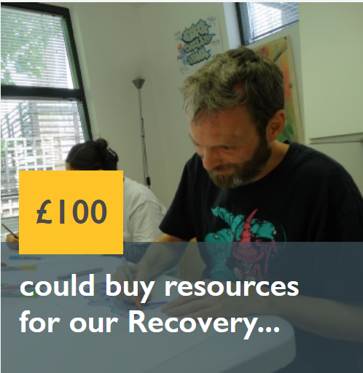

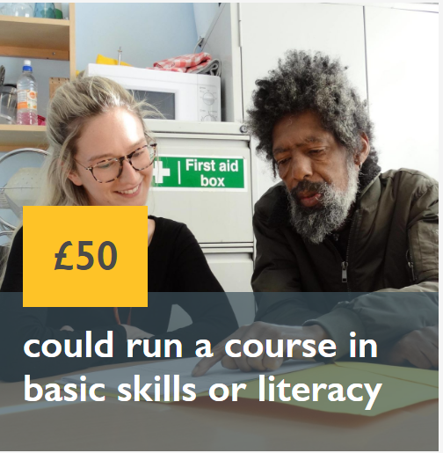
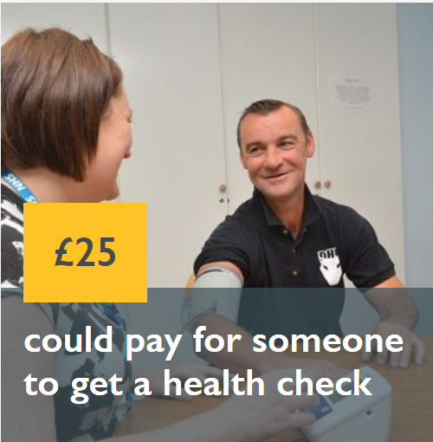
Your gift will help to transform the lives of people experiencing homelessness. People with mental and physical health needs. People on the road to recovery.
You can help give them a gift of hope for the future.
Thank you.

Slide 11

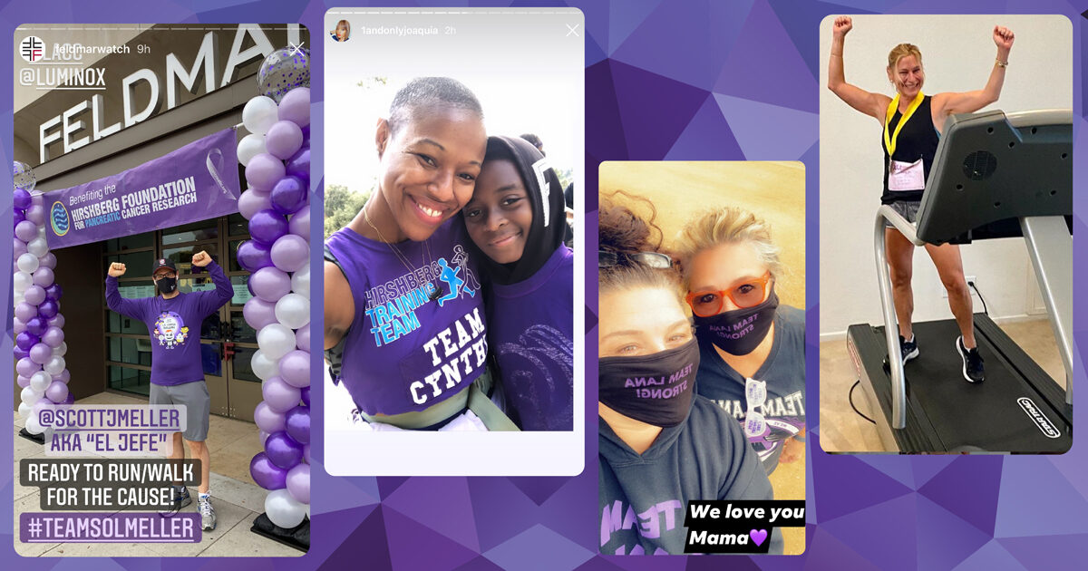
Tips
Online events using Zoom,
Use Local radio stations for promotions
Sponsorship /Corporate opportunities
Competitions third party platforms to retail products with commission
Outdoor events within Covid-19 Regulations
Direct mail through supporter base
Personal solicitation at private meetings
Online visits to talk about the organisations work
Research and look at what the large charities are doing
Develop a Digital and community fundraising plan
Campaign Activity calendar
Monitor fundraising campaign, GDPR /Consents

Slide 12
Q&A

Slide 13
Additional Sources
Social Business Investment https://www.sibgroup.org.uk | Charity Aid Foundation https://www.cafonline.org
Just Giving https://www.justgiving.com | Charity Digital https://charitydigital.org.uk
Directory Social Change https://www.dsc.org.uk | Top Website https://www.charitywater.org/uk
Virgin money giving https://uk.virginmoneygiving.com | Chartered Institute of Fundraisers https://ciof.org.uk
Fundraising UK https://fundraising.co.uk | Charity Digital Code https://charitydigitalcode.org/
Social Enterprise UK https://www.socialenterprise.org.uk | Fundraising Regulator https://www.fundraisingregulator.org.uk

Slide 14



