Slide 1

Mali Enterprising Leaders
(MEL)-England
Webinar #20 Explaining Social Impact
Date 3rd February 2021
3.30pm – 5.00pm

Slide 2

Session Outline – Social Impact
Introduction
What is social impact and why?
Different approaches to developing social impact
Producing a social impact report
Questions and answers
Closing remarks

Slide 3

Explaining Social Impact
Ade Sawyerr – Management Consultant
Ubele Associate
Fundraising Support

Slide 4
Reporting to stakeholders
The financial report reports financial activities
Increasingly need for an environmental report to placate stakeholders that we are acting responsibly
Most commercial companies are also concerned about how their organisation reacts within society – so they tag on a corporate social responsibility report
BUT not- for profit organisations are not just about money, they are about the community and how the community and individuals benefit from their activities

Slide 5
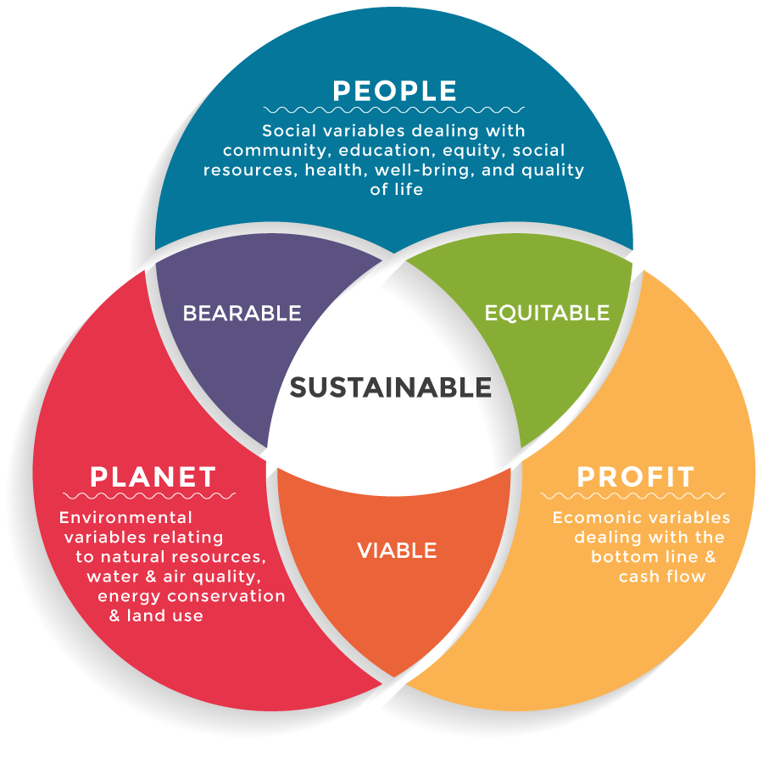
Concept of triple bottom-line
profit
viable
equitable
planet
Viable
Bearable
people
equitable
bearable

Slide 6
What is your public benefit statement?
What problems do you intend to resolve in the community
How do you intend to resolve these problems
What impact do you intend to make to individuals and community

Slide 7
Community benefit
  “The public benefits that flow from purpose
(i) are: (a) an enhanced quality of life and sense of well-being through engagement with and participation in activities and events that bring people together, leading to improvements in physical and emotional well-being, quality of life and a more stable and cohesive community; (b) increased opportunities to engage in new activities that bring people together, leading to greater social cohesion and fulfilment; (c) enhanced active citizenship and involvement in community life.
  The direct benefit that flows from purpose
(ii) is the increased efficiency and effectiveness of the community and voluntary groups and organisations that use the facilities, resulting in enhanced outcomes and service delivery and, consequently, and improved quality of life for those who benefit from the work of these groups and organisations.
The public benefits that flow from purpose
(iii) are: (a) an enhanced environment, leading to improved health and a better quality of life for the public; (b) raised awareness of environmental issues.”

Slide 8
Social impact
Social impact has been broadly defined as the effect on individuals and communities because of the actions activities: policies, programmes and projects that have been implemented by the organisation.

Slide 9
Logical framework
Project Description | Performance Indicators | Means of Verification | Assumptions
Goal: The broader development impact to which the project contributes - at a national and sectoral level. | Measures of the extent to which a contribution to the goal has been made. Used during evaluation. | Sources of information and methods used to collect and report it | External factors necessary to sustain the objectives in the long term
Purpose: The development outcome expected at the end of the project. All components will contribute to this | Conditions at the end of the project indicating that the Purpose has been achieved. Used for project completion and evaluation | Sources of information and methods used to collect and report it. | Factors and conditions necessary to achieve the objective
Outputs: The direct measurable results (goods and services) of the project which are largely under project management's control | Measures of the quantity and quality of outputs and the timing of their delivery. Used during monitoring and review. | Sources of information and methods used to collect and report it. | External conditions to be met to obtain expected results on schedule
Activities: The tasks carried out to implement the project and deliver the identified outputs. | Implementation/work program targets. Used during monitoring. What are the MEANS required to implement. People, equipment, supplies | Sources of information and methods used to collect and report it. What are the COSTS | What preconditions before the actions starts

Slide 10
Verifiable indicators
objectives | Measurement indicators | verification
goals | impact | Long term statistics
purpose | effects | Social and economic changes
outputs | outcomes | Internal reports based on numbers beneficiaries say
activities | process | Combination of staff, marketing and schedules
inputs | resources | Financial accounts of money spent

Slide 11
From problem to objectives
problem | Young African Caribbean children under-perform in secondary schools
Effect | They do not pass their exams They do not get jobs They are unemployed and a drain on the system They sometimes turn to crime
Cause | They do not have positive role models They do not think that it is cool for them to study Their schools are not good enough in the inner cities
Means | Recruit black teachers and mainly black students Teach black history as well as normal curriculum Get their parents involved in PTA and governorships
End | More positive view of themselves Being smart is cooler than being dumb at school Better results provide better options on the jobs market and more money eventually
objectives | Set up a supplementary school to provide 2 extra hours

Slide 12
Weavers objectives triangle
Overall aim
Overall aim
  ensure that young black children are motivated to achieve in the secondary school system
Specific aims
  increase positive interaction with their parents
  Increase their confidence to engage with the system
  Expand their interest in areas where they are likely to succeed
  Strengthen the bonds between the students
Activities
  Enrich the curriculum
  Provide motivating structured after-school activities
  Invite members of the community to come and talk to them about careers and options
What we want to achieve
Specific aims
Outcomes
The changes we want to take place
Activities
Outputs
What we do to achieve these

Slide 13
From problem to impact?
SOCIAL PROBLEM
community impacts
What are the problems and what are the root causes of the problem
IMPACT OPERATIONS
Organisation’s impact – programme and works
Problem solving target at root causes
MEASUREMENT
Indicators of progress and problem solving
Data capacity, collection and analysis
SOCIAL IMPACT
Short term and long-term outcomes and positive change
Learnings, growth and continuous improvement

Slide 14
What is the Theory of Change?
How do you make an impact on the community?
What are the major problems within the community
What are the causes of these problems
What can we do to resolve these causes
How do we determine the objectives of our organisation?
The five components of a Theory of Change are- Inputs, Activities, Outputs, Outcomes, and Impact.
The TOC needs to be aligned to your initiative, project, or program and stated mission.

Slide 15
A Theory of Change?
The lives of young people in the area are greatly improved through access to jobs and enterprise
impact
Increased business activity in the local area
Increased collaboration to drive more artistic trade to the local area
Work with partners to provide training programme
Provide mentors and tutors o support young people in chosen careers
Provide space for exhibition and production of goods
Develop relationship with funders
Develop relationship with corporate sponsors
Develop relationship with local business people
provision of skills to local young people
Reduction in unemployment with the local area
Enhanced Fostering a creative enterprises hub in the local area
Number of hours and young people trained
Improved exhibition space attractive
Outcomes
Activities
Inputs
outputs
Number of young people trained
Businesses recruited to and turnover generated
Assumptions: The area can be developed through collaboration between people within the community. Training programmes and access to employment and enterprise opportunities can be enhanced through targeted skills training and support. Uniquely local problems need local solutions.

Slide 16
Developing the report
Planning
What goes into the report
Executing
Who will gather what information
How we collect our information
Reporting
Contents of the report
How we are achieving sustainability
Who will feature in the report
Who will put together the report
When the report will finalised
The time frame for working on the report
Numbers served
Activities completed
Baseline of local area
People involved
Relationships established
Methods of collecting information
Resources expended
What we have achieved
How we have touched the lives of our
People How we have influenced change in our community
Who has contributed
Our partners and sponsors
What the future holds

Slide 17
Critical questions
Success and achievements
Financial
Operational
Targeted benefits
Judicious use of resources
proper application of finances and reasonable costs?
Collected all the revenue streams and displayed some entrepreneurship
donations, grants, fees and sponsorship
value for money in comparison with other agencies?
Technical competence
Innovation, Exemplar
capacity to deliver to meet our targets, necessary cost inputs to achieve results?
quality measures guide our operations and are they consistent with accepted standards and systems
Social and cultural benefits
Jobs, empowerment
Disadvantaged groups
Vulnerable groups
Children, women, ethnic minorities, old, disabled, single parents
Lessons learnt
sustainability

Slide 18
Translating operation into Impact
The goal of the operation is creating an arts and creative enterprise hub that promotes learning under one roof
The purpose is to ensure that young people are trained in the visual arts, provided opportunity to exhibit their works and become self-employed entrepreneurs
The outputs are the number of people who are trained in the different arts fields, their achievements at different stages of their engagement and what they end up accomplishing because of their association
The activities are the workplan that delivers the individual tasks, the personnel allocated to each function, the costs of materials of operation to be deployed and the space to be used to deliver these outputs. There are various other support activities for which personnel should have responsibility that includes, recruitment, management, marketing and the finance function.

Slide 19
Delivering impact
Tutors and volunteers
Training in art forms
Mentors and supporters
Exhibition space
Improved their artistic skills
Improved economic prospects for young people
Funders and donors
Contact with local businesses
Increased access to business skills
Materials and equipment
Workspace for training and production

Slide 20
Style and presentation
Present the social impact report with more graphics, infographics and pictures
Use lots of contrast and bold text on the pages
If anything can be translated into a graph, a table or diagram or matrix do so
Simplify the language used – the preference is for catch phrases and jargon
Present lots of pictures of stakeholders and their comments in boxes
Testimonials are useful as are the logos of the different sponsors, supporters, collaborators.
The more vivid the colours and the more they clash the better!

Slide 21
The Social Impact Report
introduction – from the Board
lots of infographics on Key Indicators
numbers of participants
numbers attaining different outcomes
breakdown into ages and special interest groups such as women, ethnicity
money spent per each beneficiary
value for money

Slide 22
Highlights
Provide a timeline that shows
developments and achievements over the years comparing
numbers of participants,
numbers of programmes, and
where we are now –
it can include financial information about turnover, number of staff and volunteers etc

Slide 23
Involved stakeholders
regulators
The community
Other
providers
The organisation
Members
and
Users
Staff
And
volunteers
Funders
and
commissioners

Slide 24
showcase page for stakeholders
joint work with voluntary or community sector
the objectives of the partnership
how what each partner did
how the programme or project was successful
how it was evaluated
lessons for the future

Slide 25
On each programme
describe the problem faced and reason for the programme
the goals of the programme
the purpose in terms of what is to be achieved
the activities of the programme
the participants with a break down along special interest groups
the achievements of the programme
how these were measured
a quote from feedback or evaluation report

Slide 26
Statutory sector
the goals
the work that was undertaken and why
comment from the commissioners
what was achieved
the impact on the community
how it was evaluated and the results

Slide 27
For funders
describe how the programme fit within the priorities
who the participants were
how it was undertaken
comment from funders
comment from evaluation or feedback report
where we were before the programme
impact on the participants

Slide 28
Companies and sponsors
describe the programme and reason for the relationship
how it was implemented
what was achieved
comment from the sponsors
how it was evaluated
why relationship will continue

Slide 29
Wider community
provide a baseline of the problems within the community
why you are tackling the problem
why are doing this in a particular
how you have assessed the impact
testimonial from wider beneficiaries
how the impact has been felt within the local community

Slide 30
Conclusion
the view from staff and volunteers
the view from the board
the lessons to be learnt
the next steps with the project
The Future

Slide 31
Lambeth Arts Strategy
https://www.198.org.uk/wp-content/uploads/2019/04/Young-Lambeth-Co-op_Arts-Strategy_April-2018_A5_e-version1.pdf

Slide 32
198 Social Impact Report
https://www.198.org.uk/wp-content/uploads/2020/01/AWD_198-CAL_SOCIAL-IMPACT-REPORT-2016-2019_digital.pdf

Slide 33
Q&A

Slide 34
Resources
Ubele:
https://www.ubele.org/covid19-supporting-bame-communities
London Community Foundation:
https://londoncf.org.uk/
Covid 19 Funders:
http://www.covid19funders.org.uk/
Covid-19 BAME Resource Hub:
https://sparkandco.co.uk/
Funding Central
http://www.fundingcentral.org.uk/
A searchable database of funding opportunities, Funding Central has useful advice and guidance on different sources of funding
The Resource Centre:
https://www.resourcecentre.org.uk/information/writing-a-funding-application/
Other resources
http://www.equinoxconsulting.net/resources/managementguides/budgeting.pdf

Slide 35



